Slide 1
ELECTRICAL SCIENCE-1
(15B11EC111)
Unit-1
Lecture-3
(Power and Energy analysis for circuit elements)
Dr. Abhishek Kashyap
Assistant Professor (Senior Grade, JIIT Noida)

Slide 2
Contents
Power
Energy
Power Received and Supplied by an element
Example 1
Power and energy in a resistor
Power and energy in a inductor
Power and energy in a capacitor
Example 2
Practice Problem
References

Slide 3
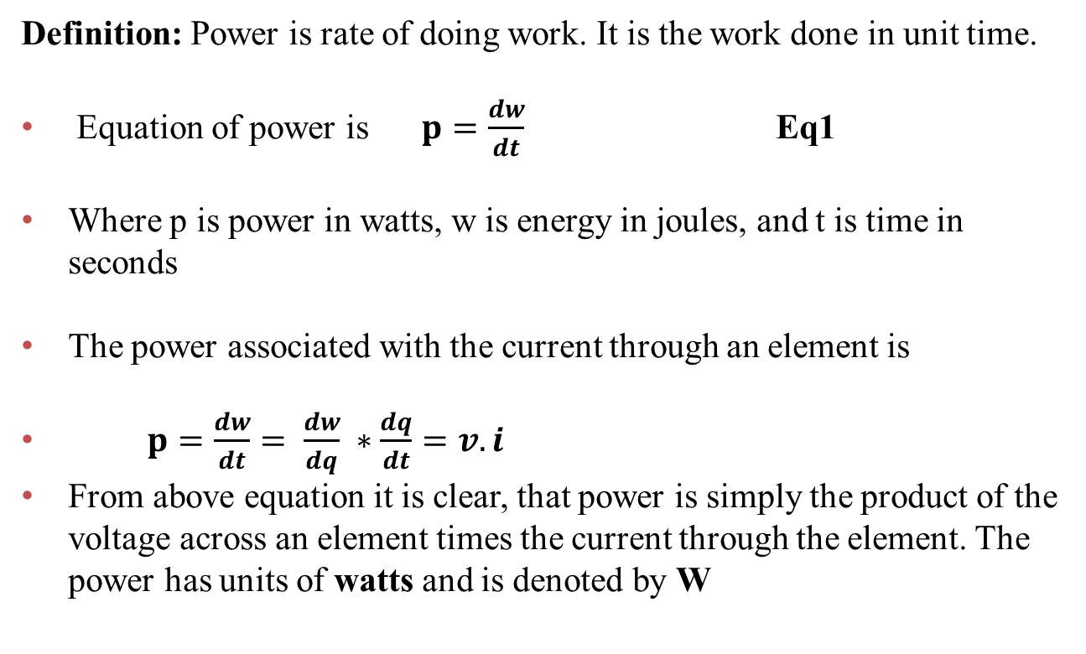
Power
Definition: Power is rate of doing work. It is the work done in unit time.
Equation of power is $p=\frac{dw}{dt}$ Eq1
Where pis power in watts, w is energy in joules, and t is time in seconds
The power associated with the current through an element is
$p=\frac{dw}{dt}= \frac{dw}{dq} ∗\frac{dq}{dt}=v.i$
From above equation it is clear, that power is simply the product of the voltage across an element times the current through the element. The power has units of watts and is denoted by W
Ref:1

Slide 4
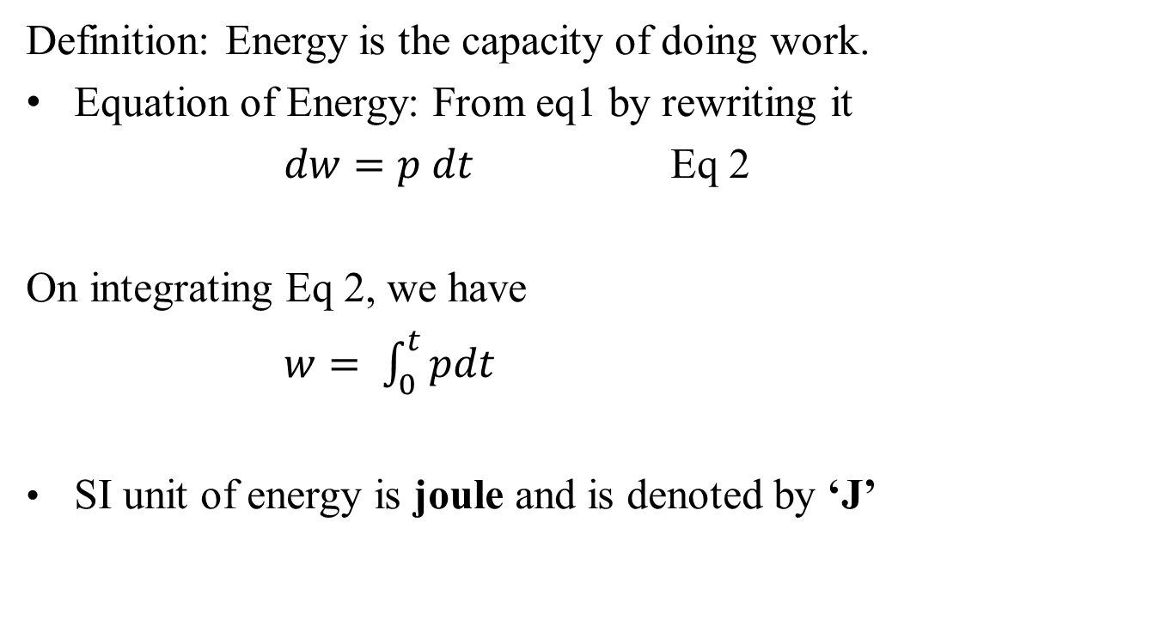
Energy
Definition: Energy is the capacity of doing work.
Equation of Energy: From eq1 by rewriting it
$dw=p dt$Eq 2
On integrating Eq 2, we have
$w= \int_{0}^{t}{pdt}$
SI unit of energy is joule and is denoted by ‘J’
Ref:1

Slide 5
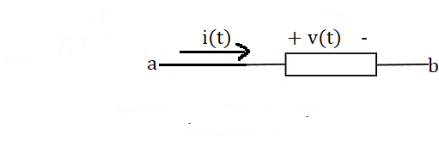
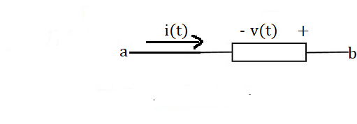
Power Received and Supplied by an element
Figure 1 shows that there are two different ways to arrange the direction of the current and the polarity of the voltage.
Power Received
In Figure 1(a), the current is directed from the + toward the – of the voltage polarity. In this the voltage and current are said to “adhere to the passive convention.”
In the passive convention, the voltage pushes a positive charge in the direction indicated by the current.
The Power calculated is known as power received
(a)
(b)
Figure 1 (a)The element voltage and current adhere to the passive convention. (b) The element voltage and current do not adhere to the passive convention.
Ref:1

Slide 6
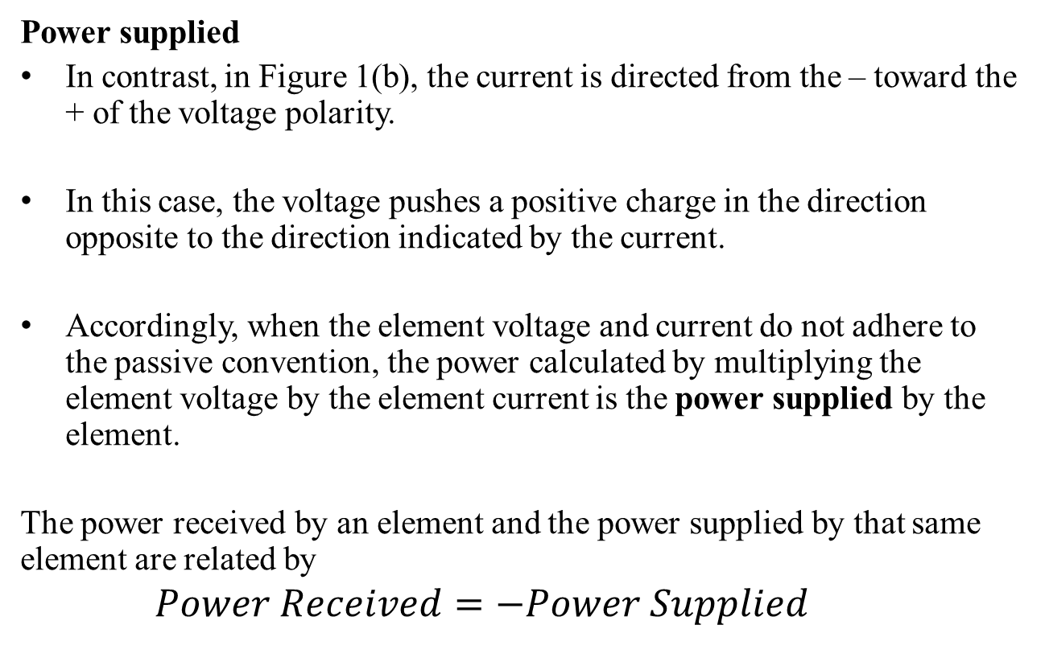
Contd..
Power supplied
In contrast, in Figure 1(b), the current is directed from the – toward the + of the voltage polarity.
In this case, the voltage pushes a positive charge in the direction opposite to the direction indicated by the current.
Accordingly, when the element voltage and current do not adhere to the passive convention, the power calculated by multiplying the element voltage by the element current is the power supplied by the element.
The power received by an element and the power supplied by that same element are related by
$$Power Received=−Power Supplied$$
Ref:1

Slide 7
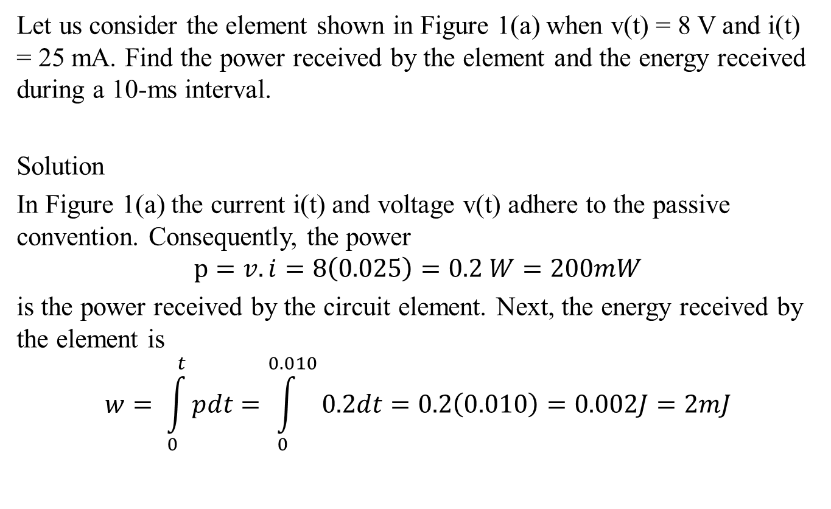
Example 1
Let us consider the element shown in Figure 1(a) when v(t) = 8 V and i(t) = 25 mA. Find the power received by the element and the energy received during a 10-ms interval.
Solution
In Figure 1(a) the current i(t) and voltage v(t) adhere to the passive convention. Consequently, the power
$$p=v.i=8\left(0.025\right)=0.2 W=200mW$$
is the power received by the circuit element. Next, the energy received by the element is
$$w= \int_{0}^{t}{pdt}=\int_{0}^{0.010}{0.2dt}=0.2\left(0.010\right)=0.002J=2mJ$$
Ref:1

Slide 8
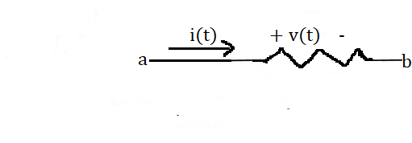
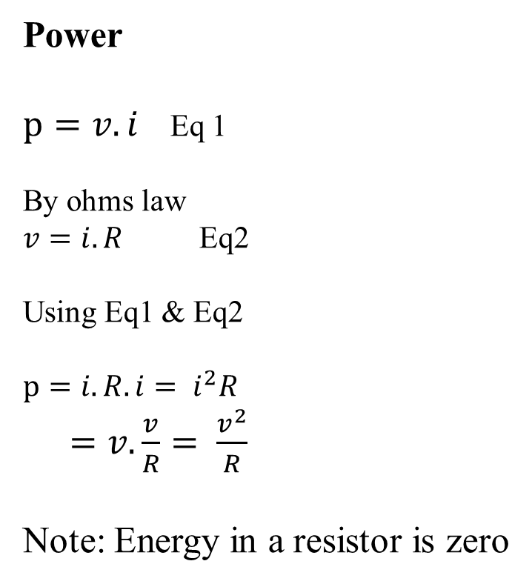
Power in a resistor
Power
$p=v.i$Eq 1
By ohms law
$v=i.R$ Eq2
Using Eq1 & Eq2
$$p=i.R.i= i^{2}R$$
$=v.\frac{v}{R}= \frac{v^{2}}{R}$
Note: Energy in a resistor is zero
R
Figure 2
Ref: 2

Slide 9
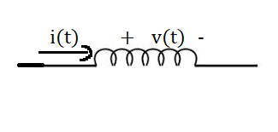
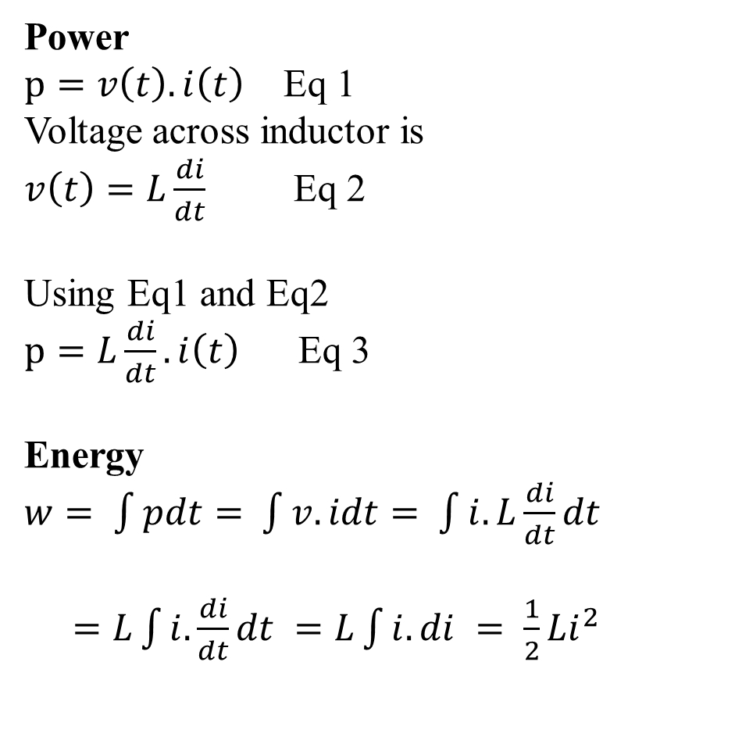
Power and energy in a inductor
Power
$p=v\left(t\right).i\left(t\right)$Eq 1
Voltage across inductor is
$v\left(t\right)=L\frac{di}{dt}$Eq 2
Using Eq1 and Eq2
$p=L\frac{di}{dt}.i\left(t\right)$ Eq 3
Energy
$w= \int{pdt= }$$\int{v.idt= }$$\int{i.L\frac{di}{dt}dt }$
$=L\int{i.\frac{di}{dt}dt }=L\int{i. di }= \frac{1}{2}{Li}^{2}$
a
b
L
Figure 3
Ref: 2

Slide 10
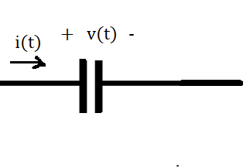
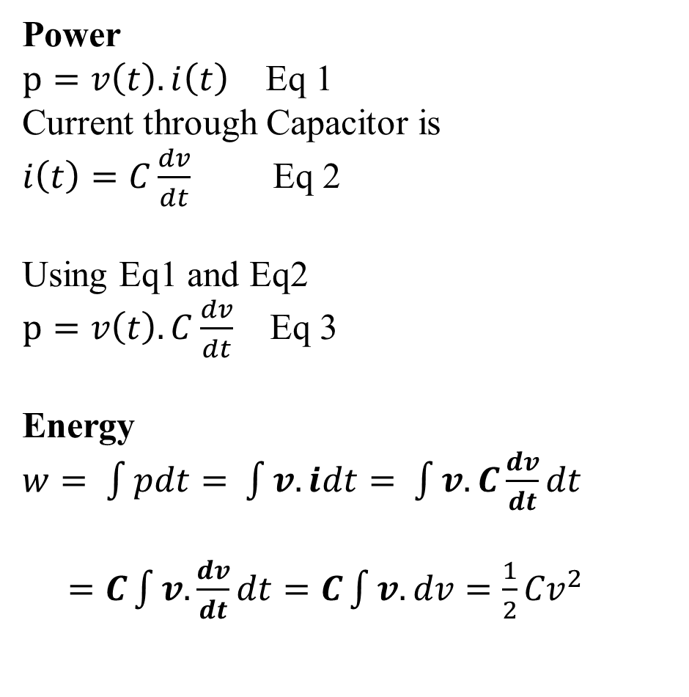
Power and energy in a capacitor
Power
$p=v\left(t\right).i\left(t\right)$Eq 1
Current through Capacitor is
$i\left(t\right)=C\frac{dv}{dt}$Eq 2
Using Eq1 and Eq2
$p=v\left(t\right).C\frac{dv}{dt}$Eq 3
Energy
$w= \int{pdt= }$$\int{v.idt= }$$\int{v.C\frac{dv}{dt}dt }$
$=C\int{v. \frac{dv}{dt}dt=C\int{v. dv=\frac{1}{2}{Cv}^{2} }}$
a
b
C
Figure 4
Ref: 2

Slide 11
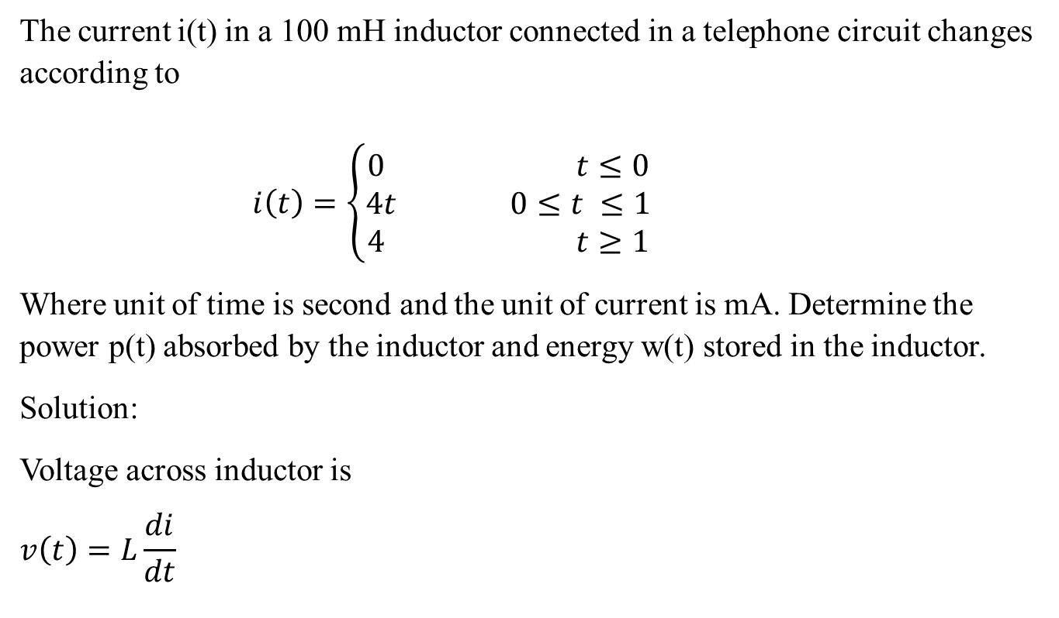
Example
The current i(t) in a 100 mH inductor connected in a telephone circuit changes according to
$i\left(t\right)=\left\{\begin{aligned}0 t≤0 \\ 4t 0≤t ≤1 \\ 4 t≥1\end{aligned}\right.$
Where unit of time is second and the unit of current is mA. Determine the power p(t) absorbed by the inductor and energy w(t) stored in the inductor.
Solution:
Voltage across inductor is
$$v\left(t\right)=L\frac{di}{dt}$$
Ref: 2

Slide 12

Contd..
$$v\left(t\right)=\left\{\begin{aligned}0 t≤0 \\ 400mV 0≤t ≤1 \\ 0 t≥1\end{aligned}\right.$$
Power
$$p=v\left(t\right).i\left(t\right)$$
So
$$p\left(t\right)=\left\{\begin{aligned}0 t≤0 \\ 1.6t 0≤t ≤1 \\ 0 t≥1\end{aligned}\right.$$
Energy
$$w=\int{pdt }$$
$$w\left(t\right)=\left\{\begin{aligned}0 t≤0 \\ 0.8t^{2} 0≤t ≤1 \\ 0 t≥1\end{aligned}\right.$$

Slide 13
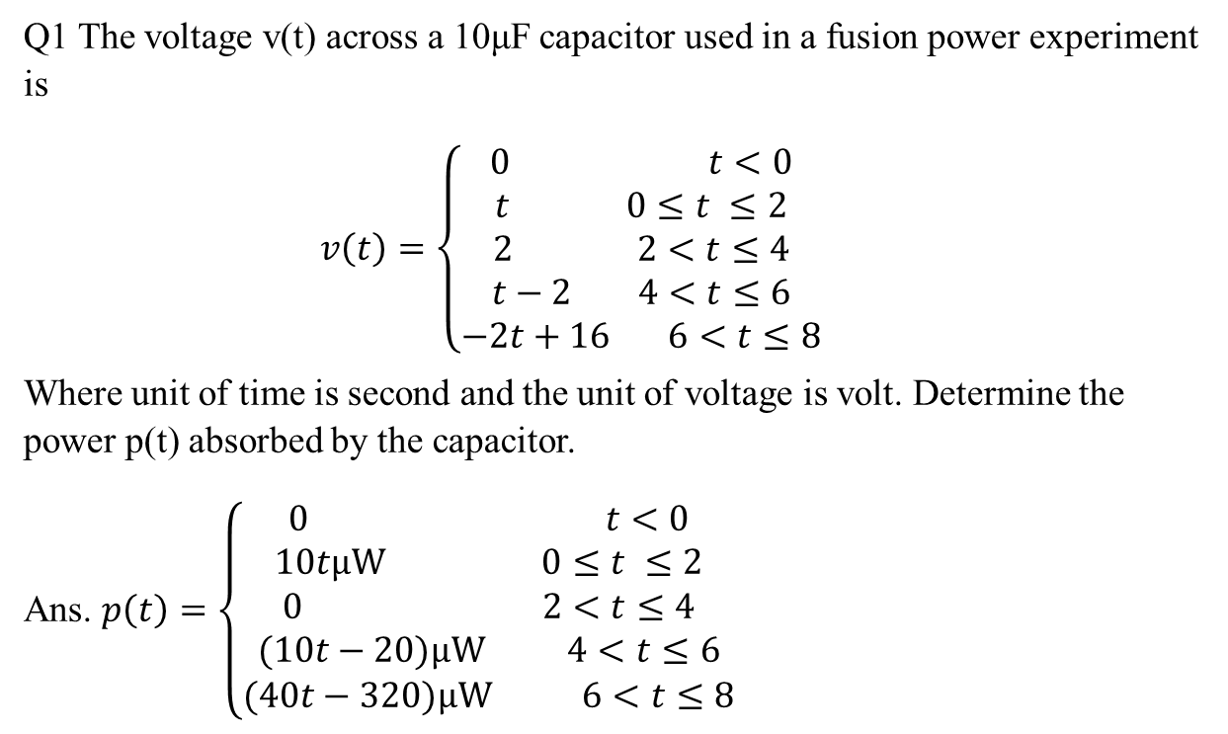
Practice Problem
Q1 The voltage v(t) across a 10μF capacitor used in a fusion power experiment is
$v\left(t\right)=\left\{\begin{aligned}0 t<0 \\ t 0≤t ≤2 \\ 2 2<t≤4 \\ t−2 4<t≤6 \\ −2t+16 6<t≤8\end{aligned}\right.$
Where unit of time is second and the unit of voltage is volt. Determine the power p(t) absorbed by the capacitor.
Ans. $p\left(t\right)=\left\{\begin{aligned}0 t<0 \\ 10tμW 0≤t ≤2 \\ 0 2<t≤4 \\ (10t−20)μW 4<t≤6 \\ (40t−320)μW 6<t≤8\end{aligned}\right.$
Ref: 2

Slide 14
References
R.C. Dorf and James A. Svoboda, “Introduction to Electric Circuits”,9th ed, John Wiley & Sons, 2013.
D.C. Kulshreshtha, Basic Electrical Engineering, Revised 1st ed, Tata Mc Graw Hill, 2017

